Slide 1
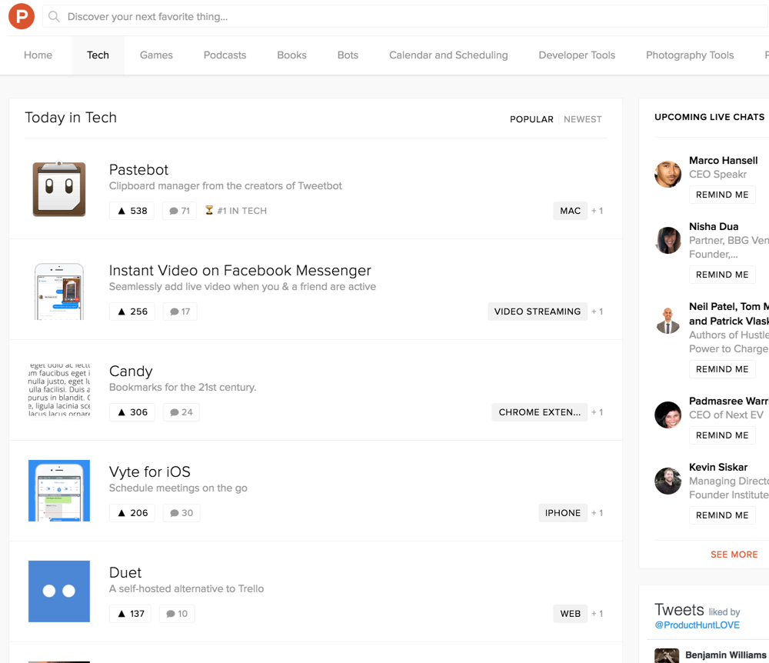






Editor
STRATEGY
Views
Summarize the main page views of the product
Summary
2
Competitive Landscape
3rd Party Services
Homepage Feed - Logged In
Initially, everything is displayed chronologically rather than algorithmically or based on votes. Since the user base will be relatively small at rst, we won’t have enough people voting to meaningfully rank products (yet).
Noti cation Events
Go to Market
DEFAULT INITIATIVE SPRINT 2 0
Subtasks (2)
Vadim Muravjov
Terminology
Personas
Goals
Index View
The Index View (ie, homepage) displays the list of posts chronologically, segmented by day (a la linkydink).
Initiatives
Labels
DEFINE
When not signed in, a CTA must be presented to signup. When signed up, a CTA to post must be present.
Onboarding
The “Hunters” (ie, contributors) must also be listed, highlighting the community of product people curating the content.
Views
Homepage Feed - Logged In
DEFAULT INITIATIVE SPRINT 1 0
Subtasks (7) 43%
Designers
DE
Index View
Home Page Feed - Not Logged
In
Detailed View
6
5
Live Feed
2
Registration
1 3
4
User Types
Phone Number Veri cation
Uploading and Feedback Media
Share a product video
Unassigned Stories
38%
1.png
1.PNG 6 Stories
1
See number of upvotes
SPRINT 1 0
DE

