Slide 1
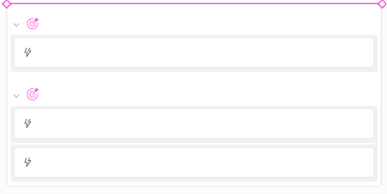

Timeline
Columns
Roadmap
Container
Q1
DEFAULT LANE
JAN 2017
FEB
MAR
17 MAR
Q2
APR
MAY
JUN
Q3
JUL
AUG
SEP
Q4
OCT
NOV
MVP
Techcrunch Disrupt
2
Big update
Version 1.0 at App Store and Google Play
Monetization Localization ES, FR, RU
Get 100 reviews
Version 2.0
Monetization Refferal program
Google Ads
Version 3.0
Big update Localization ES, FR, RU

