Slide 1
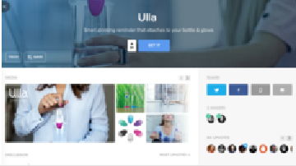

All Teams
Sprints
Backlog Workflow
In Progress
Completion Status
Order: by Date Created
Unassigned
Not started
Completed
46 Items
34 Items
21 Items
9 Items
2
Send a private message to another user
Process
BU
Referral
PM
Detailed View
PM
Go to facebook account
Add special notes
Non-Registered Users
Registered Viewers
QA
Index View
DE
Admins
PM
Detailed View
BU
Developers page story - Tags
Add description
Makers of this App
Index View
DE
Add title
Detailed View
BU
Developers page story - Number of comments
Social bar
Contributors
Detailed View
BU
Users I'm Following
PM
Business page story - Similar products
Mark a round area
Detailed View
BU
Commenting Rules
PM
Index View
DE
Mark a rectangle area
Detailed View
BU
Developers page story - See number of upvotes
Name, Title and Background Image
Simple Interactions
DE
Plugin visible button is "Finish"
Detailed View
PM
Detailed View
PM
More Advanced Interactions
DE
Product managers page story - Name, Title and Background Image
Share the video instantly on our site
Users who voted for this app
Strategy
DE
Detailed View
QA
Detailed View
BU
Share on our Vimeo channel
Vote
Index View
DE
Business page story - App Media
Toggle Popular / newest
Share on our youtube channel
Detailed View
QA
Referral
DE
Direct to product
Index View
DE
Developers - Referral
Plugin visible button is "Start"
Popularity Rank
Detailed View
PM
Commenting Rules
QA
Add a comment
App Media
Home Page Feed - Not Logged In
DE
QA - Commenting Rules
Detailed View
PM
Live Feed
PM
Add an image to your comment
Proactively asking for user feedback
Activity Row
Visit URL in browser browser
Detailed View
PM

